Slide 1

INCLUSIVE HIRE
SNEHA KP
MES24MCA-2054
Department of Computer Applications
MES College of Engineering, Kuttippuram
20/08/2025

Slide 2
PRODUCT OWNER Ms . C M SULAIKHA ASSISTANT PROFESSOR DEPARTMENT OF COMPUTER APPLICATIONS MES COLLEGE OF ENGINEERING, KUTTIPPURAM

Slide 3
TABLE OF CONTENTS
Introduction
Objective
Existing System
Proposed System
Motivation
Functionalities
Module Description
Developing Environment
Sprint Backlog
Product Backlog
User Story
Project Plans
Data Flow Diagrams
ER Diagram

Slide 4
INCLUSIVE HIRE
Differently-abled individuals in Kerala face barriers in finding suitable employment.
Existing job portals lack accessibility features and inclusive job filters.
Inclusive-Hire is developed as a Flutter-based mobile app to bridge this gap.

Slide 5
INCLUSIVE HIRE
Enables accessible job search and inclusive employer hiring.
Supports disability-based filters, accommodation needs, and local languages .

Slide 6
OBJECTIVES
Provide an accessible job portal for differently-abled job seekers.
Allow employers to post inclusive job vacancies with accommodation details.
Implement features like screen reader support, text scaling, and high-contrast themes.
Support district-wise job search and multilingual UI.
Ensure cross-platform availability (Android, iOS, Web).

Slide 7
EXISTING SYSTEM
Mainstream job portals lack disability-specific filters and accessibility support.
Employers find it difficult to reach differently-abled candidates.
Lack of integration with local government or NGO initiatives.
Poor UX for users with impairments.

Slide 8
PROPOSED SYSTEM
User-friendly accessible UI built with Flutter.
Backend powered by Firebase for real-time updates and authentication.
Disability-aware profiles and role-based access.
Employer dashboard to manage job postings and applications.
Support for local languages and district-wise filtering.

Slide 9
MOTIVATIONS
Address employment inequality faced by differently-abled individuals.
Promote digital inclusion and social equity.
Leverage mobile and cloud technologies to improve outreach and ease of use.
Align with Kerala’s inclusive employment policies and NGO efforts.

Slide 10
FUNCTIONALITIES
User registration and profile creation with accessibility options.
Job search with filters by disability type, accommodation, skills, and location.
Employer job posting and application management.

Slide 11
FUNCTIONALITIES
Notification system for job updates and application status.
Cross-platform access (mobile and web).

Slide 12
MODULE DESCRIPTION
User Module: Registration, login, profile management with accessibility features.
Job Module: Search, filter, view job postings.
Employer Module: Post jobs, view/manage applications.

Slide 13
MODULE DESCRIPTION
Notification Module: Real-time alerts on application status.
Admin Module: User verification, job approval, and system monitoring.

Slide 14
DEVELOPING ENVIRONMENT
Operating System: Windows
Frontend: Flutter (Dart)
Backend: Firebase (Authentication, Firestore, Cloud Messaging)
Database: SQLite
IDE: Visual Studio Code

Slide 15
SPRINT BACKLOG
Backlog tem | Status And Completion Date | Original Estimation in Hours | Day 1 hrs | Day 2 hrs | Day 3 hrs | Day 4 hrs | Day 5 hrs | Day 6 hrs | Day 7 hrs | Day 8 hrs | Day 9 hrs | Day 10 hrs
SPRINT1
UI Design (Login, Register) | 21/08/2025 | 6 | 1 | 1 | 1 | 1 | 1 | 1 | 0 | 0 | 0 | 0
Authentication (Firebase) | 24/08/2025 | 5 | 1 | 1 | 1 | 1 | 1 | 0 | 0 | 0 | 0 | 0
Profile Creation Module | 27/08/2025 | 6 | 1 | 1 | 1 | 1 | 1 | 1 | 0 | 0 | 0 | 0
SPRINT 2
Job Posting (Employer) | 01/09/2025 | 8 | 1 | 1 | 1 | 1 | 1 | 1 | 1 | 1 | 0 | 0
Job Search & Filtering | 05/09/2025 | 7 | 1 | 1 | 1 | 1 | 1 | 1 | 1 | 0 | 0 | 0

Slide 16
SPRINT BACKLOG
Backlog tem | Status And Completion Date | Original Estimation in Hours | Day 1 hrs | Day 2 hrs | Day 3 hrs | Day 4 hrs | Day 5 hrs | Day 6 hrs | Day 7 hrs | Day 8 hrs | Day 9 hrs | Day 10 hrs
SPRINT3
Accessibility Features | 10/09/2025 | 9 | 1 | 1 | 1 | 1 | 1 | 1 | 1 | 1 | 1 | 0
Notifications & Alerts | 14/09/2025 | 6 | 1 | 1 | 1 | 1 | 1 | 1 | 0 | 0 | 0 | 0
SPRINT 4
Testing & Bug Fixing | 8/10/2025 | 8 | 1 | 1 | 1 | 1 | 1 | 1 | 1 | 1 | 0 | 0
Deployment & Documentation | 12/10/2025 | 6 | 1 | 1 | 1 | 1 | 1 | 1 | 0 | 0 | 0 | 0
TOTAL |  | 61 | 9 | 9 | 9 | 9 | 9 | 8 | 4 | 3 | 1 | 0

Slide 17
PRODUCT BACKLOG
ID | NAME | PRIORITY <high/medium/low> | ESTIMATE (Hours) | STATUS <Planned/In progress/Completed>
1 | USER REGISTRATION | High | 5 | PLANNED
2 | LOGIN WITH OTP | High | 5 | PLANNED
3 | JOB POSTING | High | 15 | PLANNED
4 | SEARCH & FILTER | High | 10 | PLANNED

Slide 18
USER STORY
User Story ID | As a type of User | I want to <Perform some task> | So that i can <Achieve Some Goal>
1 | JOB SEEKER | Register and create profile | Access job listings easily
2 | EMPLOYER | Post job listings | Hire suitable candidates
3 | JOB SEEKER | Filter jobs by accommodation | Find suitable job options
4 | ADMIN | Verify users and jobs | Maintain platform integrity

Slide 19
PROJECT PLAN
User StoryID | Task Name | Start Date | End Date | Days | Status
1 | SPRINT 1 | 21/08/2025 | 23/08/2025 | 9 | Planned
2 |  | 24/08/2025 | 26/08/2025 |  | Planned
2 |  | 27/08/2025 | 29/08/2025 |  | Planned
2 | SPRINT 2 | 30/08/2025 | 01/09/2025 | 16 | Planned
3 |  | 02/08/2025 | 05/09/2025 |  | Planned

Slide 20
PROJECT PLAN
User StoryID | Task Name | Start Date | End Date | Days | Status
1 | SPRINT 3 | 06/09/2025 | 10/09/2025 | 9 | Planned
2 |  | 11/09/2025 | 14/09/2025 |  | Planned
4 | SPRINT 4 | 15/09/2025 | 08/10/2025 | 26 | Planned
4 |  | 09/10/2025 | 12/10/2025 |  | Planned

Slide 21
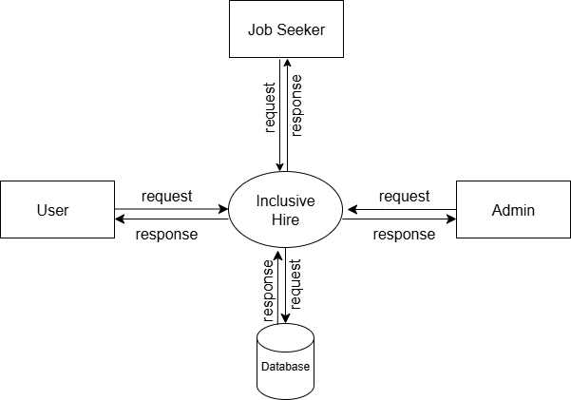
DATA FLOW DIAGRAM
Level 0

Slide 22
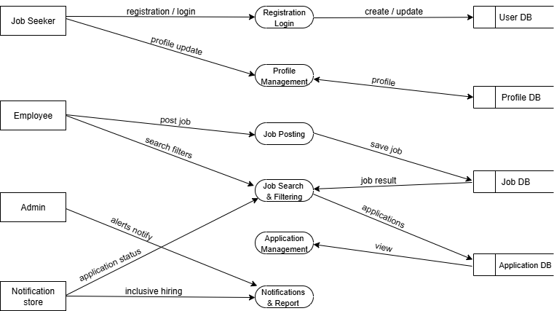
DATA FLOW DIAGRAM
Level 1

Slide 23
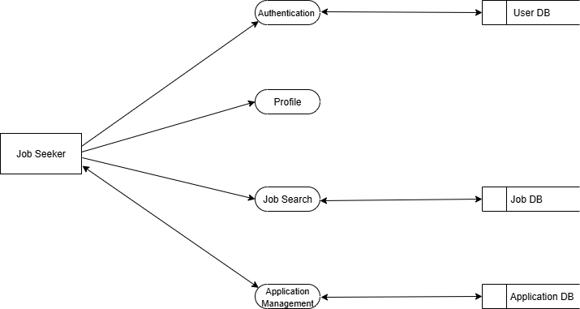
DATA FLOW DIAGRAM
Level 1.1

Slide 24
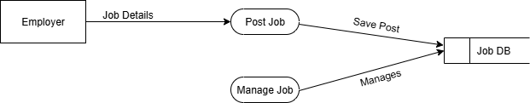
DATA FLOW DIAGRAM
Level 1.2

Slide 25
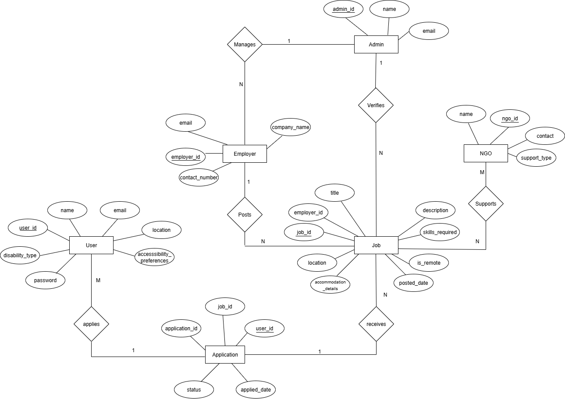
ER DIAGRAM

Slide 26
THANK YOU

